Slide 1
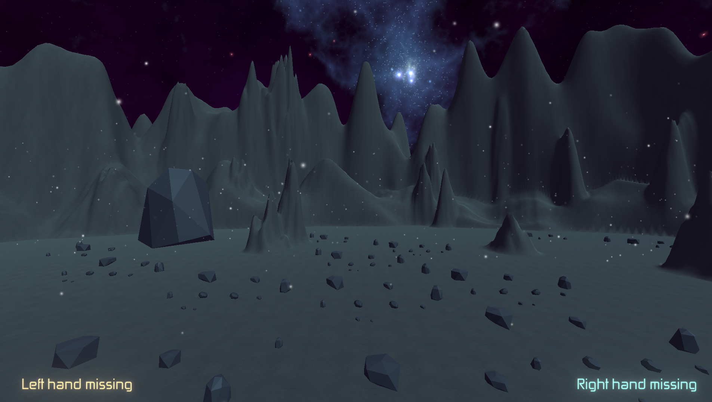
Hand Tracking with Gesture Recognition
Author: Alexandros Filios - mtn2219

Slide 2
Multimodal Machine Learning
National Centre of Scientific Research "Demokritos"
Author: Alexandros Filios - mtn2219

Slide 3
Introduction
01
METHODOLOGY
02
Table of contents
IMPLEMENATION
03
FUTURE WORK
04
Purpose of the project.
Technologies used.
Creation and results
Extendibility and other ideas

Slide 4
01 Introduction
Overview of the Project
Scope and Objectives
Structure of the Project

Slide 5
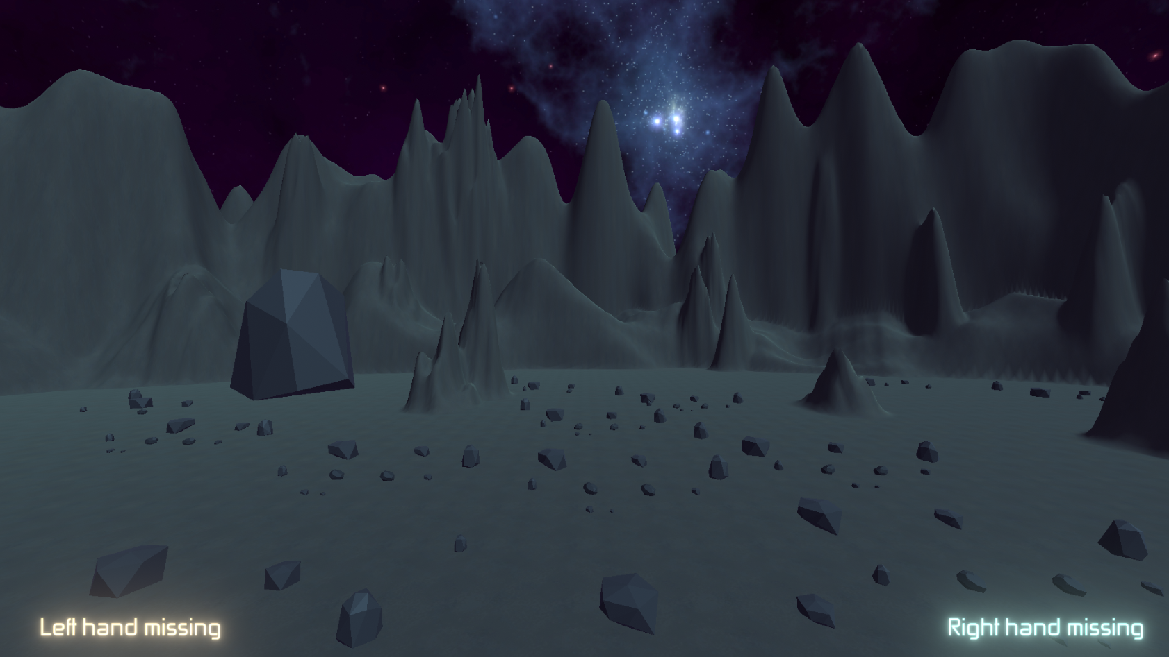
Overview of the Project
Artificial intelligence (AI) in video games
Virtual reality (VR) and augmented reality (AR)
Multimodal machine learning

Slide 6
Scope and Objectives
Structure of the Project
Demonstrate of Mediapipe for hand gesture recognition in Unity3D
Comprehensive understanding of Mediapipe's hand tracking feature
Framework for extensible gesture recognition
Overview of technologies used
Detailed account of implementation
Results and evaluation of gesture recognition mechanism
Discussion of limitations and opportunities for further research and development

Slide 7
02 Methodology
Unity 3d engine
Mediapipe

Slide 8

Unity
Animation
Real-time 3D creation
Audio
Virtual Reality - Augmented Reality
Physics engine
Scripting

Slide 9

MediaPipe
Object detection
Image classification
Image segmentation
Gesture recognition
Face landmark detection
Hand landmarks detection

Slide 10
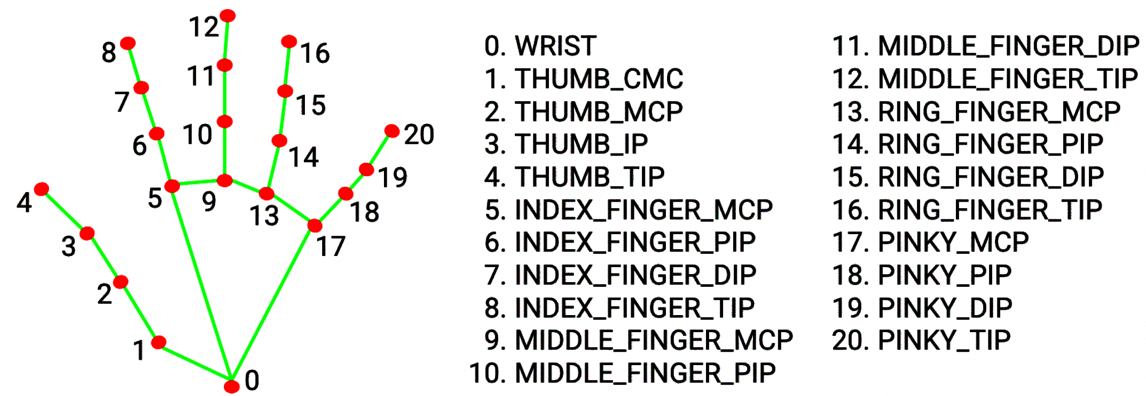
Gesture recognition

Slide 11
03 IMPLEMENTATION
SCENE SETUP
Code
OPTIMIZATION

Slide 12
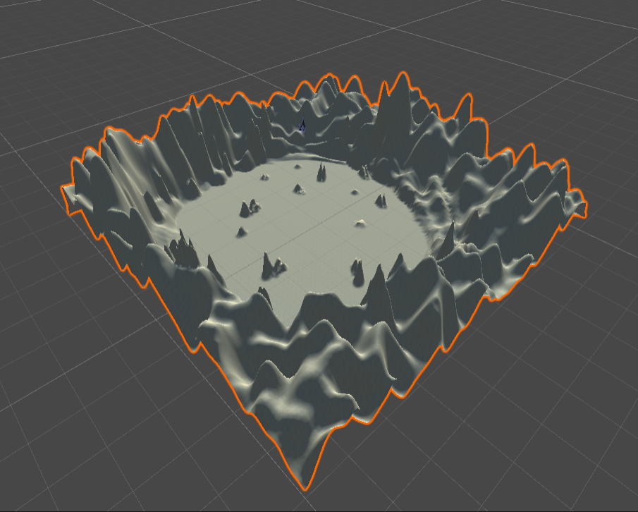
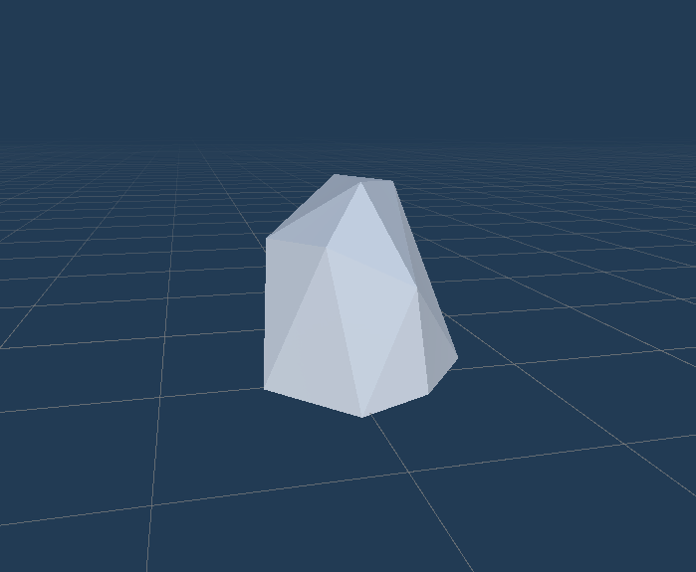
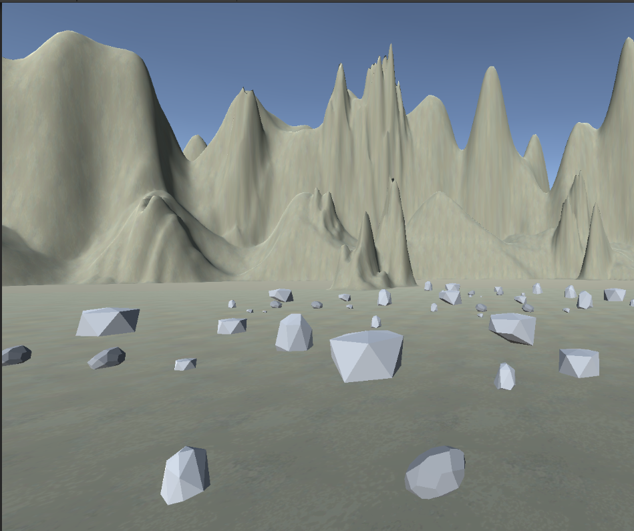
SCENE SETUP
TERRAIN ENVIRONMENT
ROCKS PREFABS
FPS PERSPECTIVE

Slide 13
Code
Game manager
HAND MANAGER
GESTURE MANAGER
LEFT HAND
RIGHT HAND
GESTURES
POWER MANAGER
Responsible for the hand tracking
Responsible for the gesture checks

Slide 14
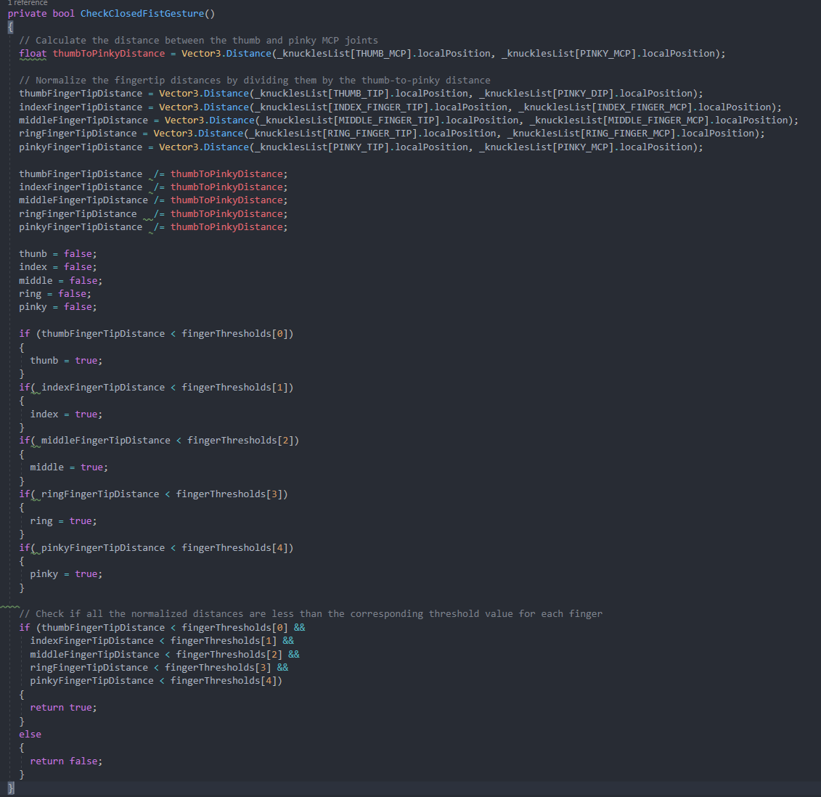
Gesture recognition

Slide 15
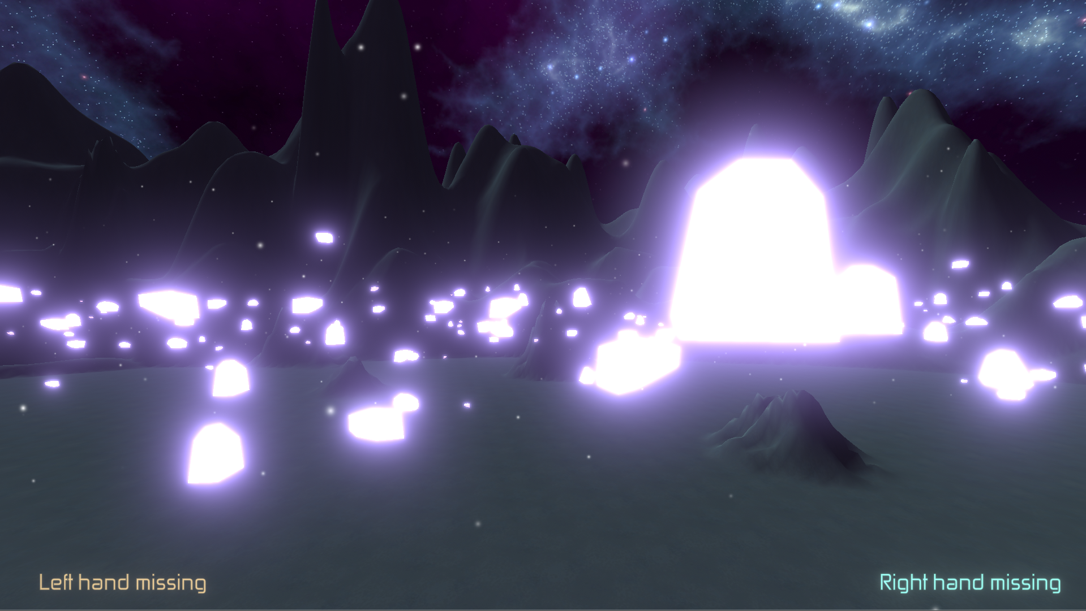
RESULTS
TELEKINESIS EFFECT

Slide 16
FUTURE WORK
Developing more complex gesture recognition tasks
Incorporating more sensory input, such as voice or eye-tracking
Create games that use only such input

Slide 17
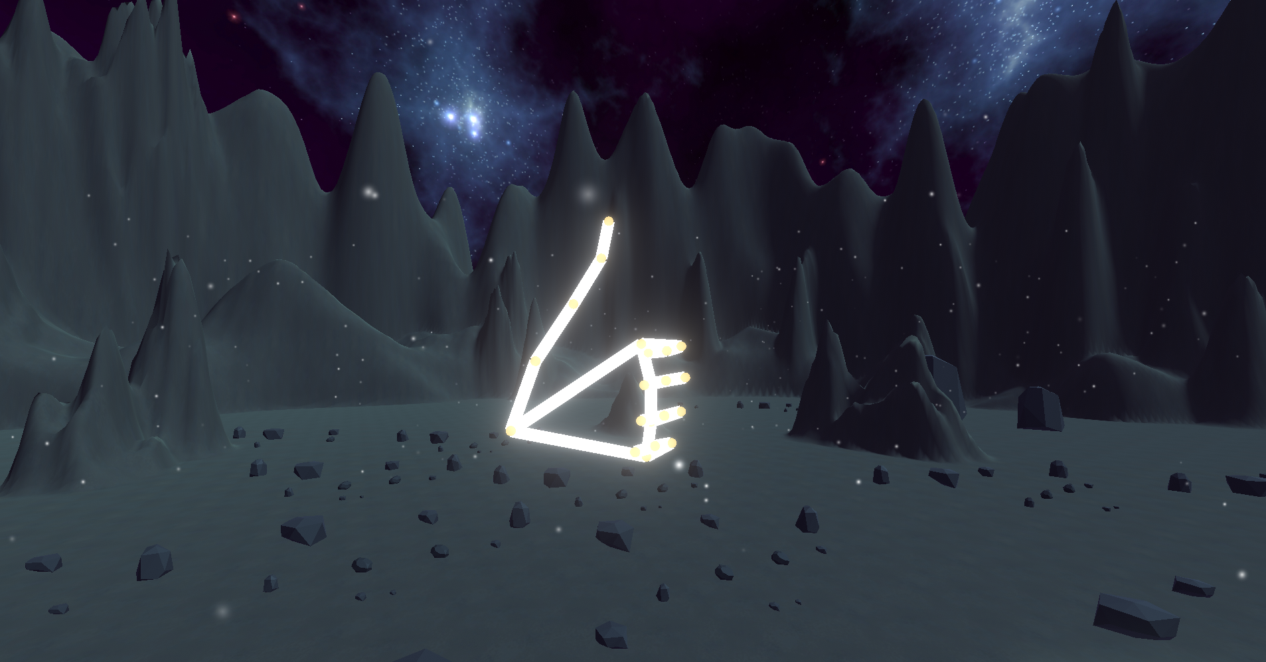
Thanks

